Slide 1
Personal Finance and Financial Independence
Brian Hartman
Brigham Young University
Note: I am not a certified financial planner, so this should not be taken as fiduciary advice.

Slide 2
Your life in 5-7 years
Write down a few characteristics of an optimistic (but still reasonable) version of your life in 5-7 years.
Family
Career
Home
Hopes and dreams
Average 2023 health insurance actuary salary, 6 years of experience
ASA: 145K
FSA: 180K

Slide 3
Your life in 5-7 years adjusted
Now assume that your great aunt gives you an annuity which pays $100K/year until you and your spouse (if applicable) both die.
Now write down how your life will be
In the first year
For the rest of your life

Slide 4
Financial Independence
When you no longer need to work for money to support your life
You can still get paid for work if you want
Benefits
Flexibility at work if you want to keep your job
Try risky things which could benefit a lot of people
Help others easily
Relax
Spend more time with your family or serving others

Slide 5
Financial Math of Financial Independence
You will be saving a certain amount each year (hopefully interest-bearing).
The future value of those deposits needs to equal the present value of a perpetuity paying your expenses every year for the rest of your life.

Slide 6
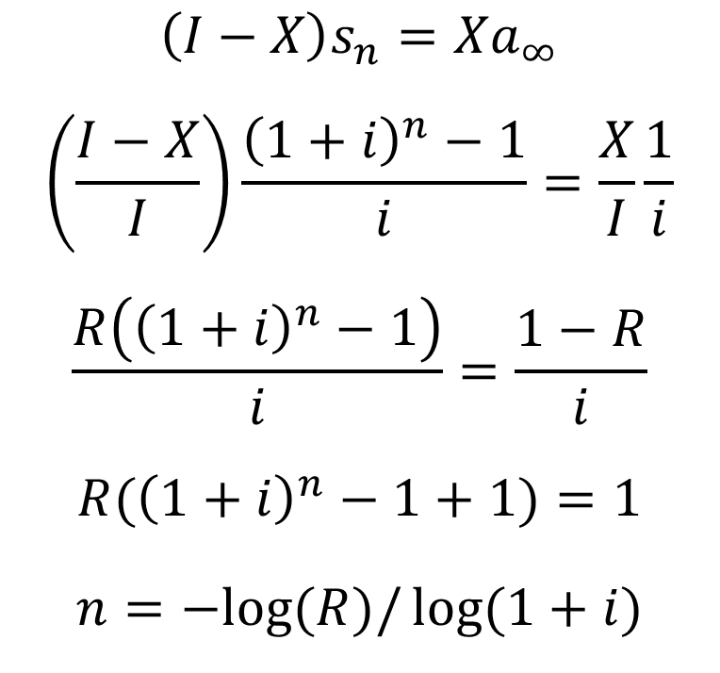
Financial Math of Financial Independence
$$\left(I−X\right)s_{n}=Xa_{∞}$$
$$\left(\frac{I−X}{I}\right)\frac{{\left(1+i\right)}^{n}−1}{i}=\frac{X}{I}\frac{1}{i}$$
$$\frac{R\left({\left(1+i\right)}^{n}−1\right)}{i}=\frac{1−R}{i}$$
$$R({\left(1+i\right)}^{n}−1+1)=1$$
$$n=−log⁡(R)/\log{(1+i)}$$
$n$ is number of years until financial independence
$I$ is annual (after-tax) income
$X$ is annual expenses
$1−\frac{X}{I}$ is your savings rate, $R$
Notice that the time until financial independence only depends on $R$

Slide 7
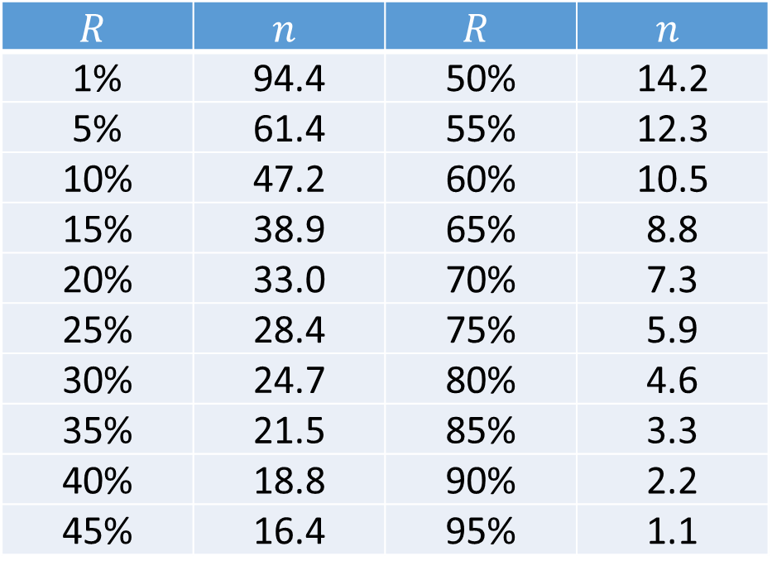
Years until Financial Independence ($i=0.05$)
$$R$$ | $$n$$ | $$R$$ | $$n$$
1% | 94.4 | 50% | 14.2
5% | 61.4 | 55% | 12.3
10% | 47.2 | 60% | 10.5
15% | 38.9 | 65% | 8.8
20% | 33.0 | 70% | 7.3
25% | 28.4 | 75% | 5.9
30% | 24.7 | 80% | 4.6
35% | 21.5 | 85% | 3.3
40% | 18.8 | 90% | 2.2
45% | 16.4 | 95% | 1.1

Slide 8
Benefits of Progress
You don’t need to wait until financial independence to get benefits
On the journey you will get
Less anxiety around money
More ability to handle unexpected expenses
More ability to give and help
Increased agency with career and side hustles
Better understanding of what is truly important to you
Clearer picture of what you would want to do with no money constraints

Slide 9
Flexibility at Work
If you no longer need the job you have (or at least have a year or so of expenses saved up), you have a lot more flexibility.
No longer afraid to ask for part-time/remote work
You don’t have to take consulting gigs just for the money
Want to take six months off and travel the world?
Want to serve a mission?
Don’t want to move to headquarters?
Don’t want to become a manager?

Slide 10
What if I love my job? Should I do this?
No matter how close to infinite your income, it is always finite. Make the best use of it
Help as many people as you can
Help your children to expect a “normal” amount of spending
Median household income in US is around $74.5K
Your amount of spending is what your kids will come to think is normal
Don’t provide economic outpatient care (Millionaire Next Door)

Slide 11
How Do I Start?
Spend less than you make
Budgeting
Understanding what actually makes you happy (memories/experiences) and what usually doesn’t (things)
Set up an emergency fund (3-6 months of expenses)
Get out of debt
Invest
Keep going

Slide 12
Budgeting
How much to spend each month?
Should be less than you earn
How much less?
What should we spend money on? What will actually improve our life?
Memories?
Conveniences?
Eating out?
Clothes?
Car?
House?
Toys? (either for kids or adults)
Not meant to restrict, rather to align with goals

Slide 13
Emergency Fund
Take it out of your checking account
Help you not spend it
Earn a better interest rate (current market rates are around 4.5%)
Make it automatic as you are filling it up (direct deposit X% of your paycheck)
Know your goal amount (invest above that)

Slide 14
Investing
Make sure to get your entire company 401K match
Make it simple
Broad index mutual fund
Indexing vs. active investing
IRAs, both Roth (after-tax) and Traditional (before-tax)
Tax-advantaged account comparison

Slide 15
A House is a Terrible Investment (jlcollinsnh.com)
A terrible investment should:
Be an ongoing cash drain
Be illiquid
Have high transaction costs
Be complex to buy and sell
Provide low returns
Be highly leveraged and mortgaged
Be unproductive, no interest or dividends
Be immobile
Be dependent on the fortunes of one neighborhood
Make it difficult for an owner to leave
Be expensive to purchase and own
Heavily taxed
Exposed to elements (fire, hail, vandalism, etc.)

Slide 16
Wait, don’t you own a house? Should I?
Only own a house when it will bring you joy and you are willing to put up with the disadvantages.
When you want:
Yard or other things not easily found in the rental market
Certain location
Ability to customize
Consistent payment
Current job situation (flexibility, commute, etc.)
And can deal with:
Large upfront costs (down payment, repairs, etc)
Unexpected expenses
Maintenance time (and/or expenses)

Slide 17
How much house can I afford?
Very different question from “How much of a loan can I qualify for?”
If you buy an unaffordable house, it will almost surely not be a joy.
Online spreadsheet
Rough rules of thumb
Have at least 20% down payment
Qualify for 15-year mortgage
Able to pay it off in a reasonable amount of time

Slide 18
Other Important Considerations
Kids’ education (529 accounts)
Paying off your mortgage
Careful in the amount of help you provide people you care about
Don’t let the goal get in the way of more important things

Slide 19
Insurance
Insurance protects against financial loss
Only insure what would cause significant financial harm
Not calculators
Not kids (almost always)
Maybe not comp and collision

Slide 20
How to make more money
Build your skills
Be productive by prioritizing (sometimes that means saying no)

Slide 21
Other Resources
The Simple Path to Wealth, Jim Collins
Your Money or Your Life, Vicki Robin
The Millionaire Next Door, Thomas Stanley and William Danko
I Will Teach You to be Rich, Ramit Sethi
Happy Money, Elizabeth Dunn and Michael Norton
jlcollinsnh.com
madfientist.com
mrmoneymustache.com
Pretty much anything under FIRE (Financial Independence, Retire Early)

