Slide 1
Stat 444 Announcements
Winter 2024

Slide 2
09 January 2024
My office hours: M 9-10, Tu 8-9, W 10:30-11:30
Exams, homework, calculators, book
It’s great to be wrong, don’t be timid
TAs:
Zach Sabey
Office hours M 11-12, Tu 12-1, W 3:30-5:30, Th 9-12
Online tools
ACTEX
Infinite Actuary
Coaching Actuaries

Slide 3
09 January 2024
SOA Center of Actuarial Excellence
CAS University Award
University Earned Credit
Exam ALTAM
6 WA Questions
3 hours
Apr, Oct
Exam Reimbursements
Diversity Exam Reimbursement
Collings Actuarial Fund
Alumni donations
Reimburse all UEC exams
Statistics Club
Internship Extravaganza, Wed Jan 17th 6 pm WVB 1151
Join the actuarial mailing list: career.placement@stat.byu.edu

Slide 4
09 January 2024
Let’s meet each other
Name
Hometown
Why are you taking this class?
What do you like to do outside of class?
What questions do you have about the course or the program?
What are your career plans?

Slide 5
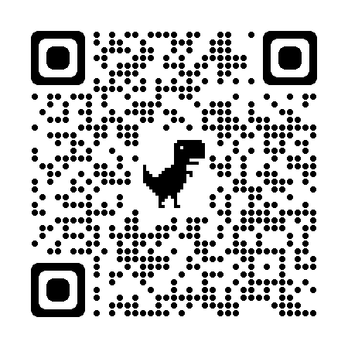
11 January 2024
Homework #1 due Jan 25th in class
UEC Authorization
Internship Extravaganza, Wed Jan 17th 6 pm WVB 1151

Slide 6
16 January 2024
Homework #1 due Jan 25th in class
UEC Authorization
Internship Extravaganza, Wed Jan 17th 6 pm WVB 1151

Slide 7
18 January 2024
Homework #1 due Jan 25th in class
UEC Authorization
Game Picker
Thursday Question
Name
Hometown
Dream city to live in

Slide 8
2024-2025 Stats Club Leadership Q&A -
1/25 11 am @ WVB 1161 (Bagels provided)
Statistics Academic Tourney -
2/8 6 pm @ WVB 1161 (Pizza provided)
Movie Night: Moneyball -
2/15 7 pm @ WSC Varsity Theater
Biostatistics Social -
2/20 6 pm @ WVB 1151/1155 (Pizza provided)
Case Study Introduction/Kick-off -
2/27 5 pm @ WVB 1161 (Refreshments provided)

Slide 9
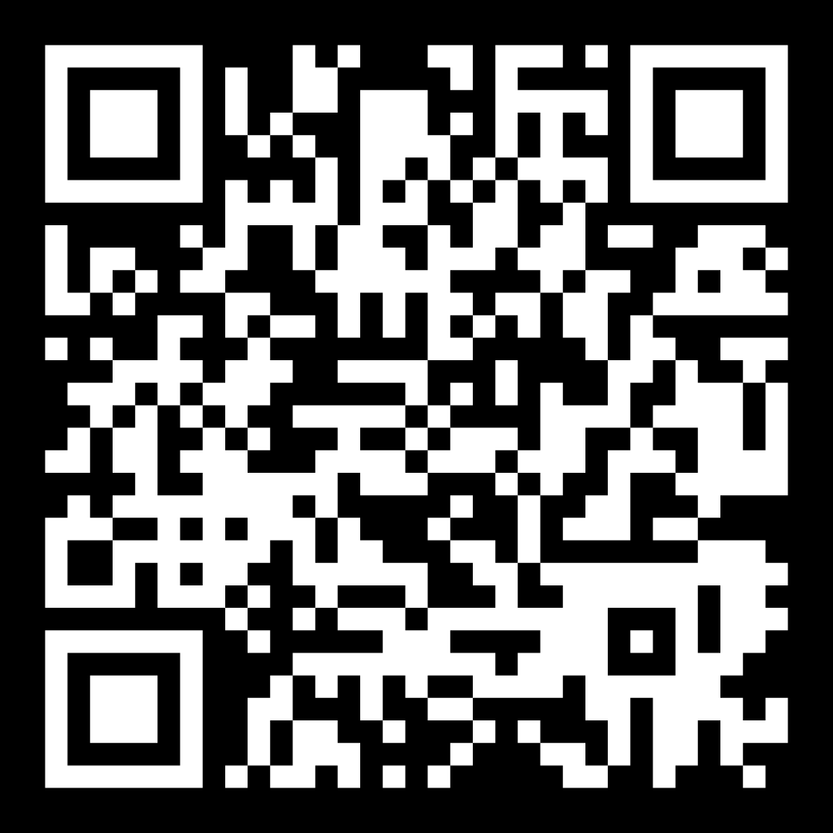
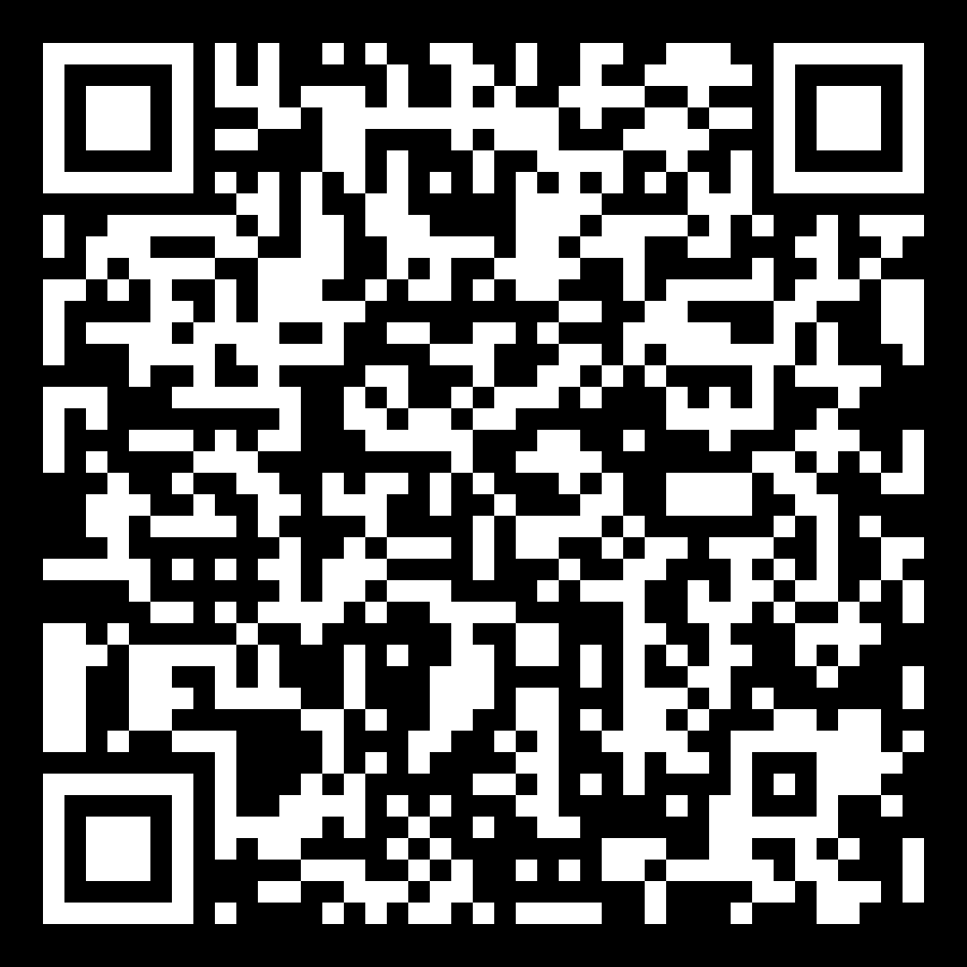
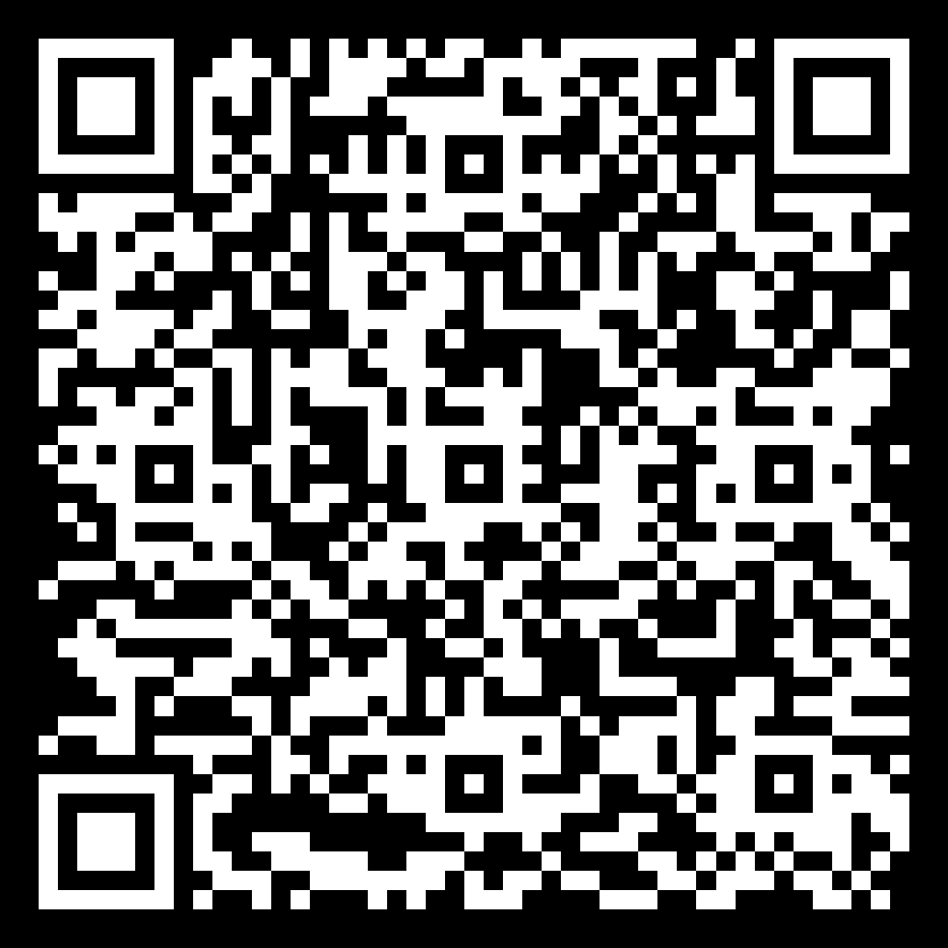
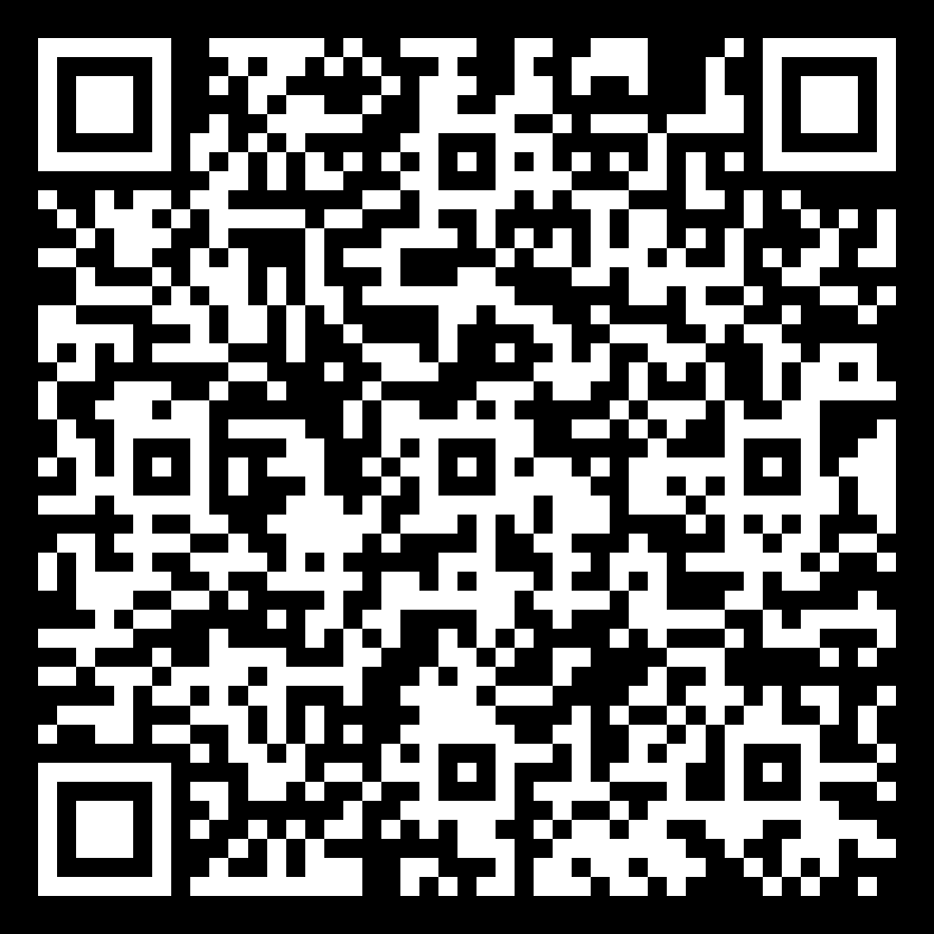
Statistics Academic Tourney (2/8)
2024-25 Club Leadership Interest Form
Club peer mentorship
Join our Club!
Tip: Some phones can take a picture and hold their finger on each code
Notes:
Add Join Stats club QR code.
Students can also reach out to STAT 240, STAT 230, STAT 250,
Each student tells their professor about being in stats club leadership saying being willing to talk about events going on

Slide 10
23 January 2024
Homework #1 due Thursday Jan 25th
Upcoming events
1/25, Stats club leadership Q&A, 11:00 am, WVB 1161
2/7, Security Health Plan of WI, 4 pm, 1159 WVB
2/8, Statistics Academic Tourney, 6 pm, WVB 1161
2/15, Movie night: Moneyball, 7 pm, Varsity Theater
2/20, Biostatistics Social, 6 pm, WVB 1151
2/27, Case Study Kick Off, 6 pm, WVB 1151

Slide 11
25 January 2024
Homework #1 due
Homework #2 posted, due February 8th
Thursday Question
Full Name
Hometown
What is your favorite sport/hobby to watch/play?
Upcoming events
2/7, Security Health Plan of WI, 4 pm, 1159 WVB
2/8, Statistics Academic Tourney, 6 pm, WVB 1161
2/15, Movie night: Moneyball, 7 pm, Varsity Theater
2/20, Biostatistics Social, 6 pm, WVB 1151
2/27, Case Study Kick Off, 6 pm, WVB 1151

Slide 12
30 January 2024
Homework #2 Due February 8th
Upcoming events
2/7, Security Health Plan of WI, 4 pm, 1159 WVB
2/8, Statistics Academic Tourney, 6 pm, WVB 1161
2/15, Movie night: Moneyball, 7 pm, Varsity Theater
2/20, Biostatistics Social, 6 pm, WVB 1151
2/27, Case Study Kick Off, 6 pm, WVB 1151

Slide 13
1 February 2024
Homework #2 Due February 8th
Thursday Question
Full Name
Hometown
What is the furthest from Utah you have ever lived (both mission and non-mission)?
Upcoming events
2/7, Security Health Plan of WI, 4 pm, 1159 WVB
2/8, Statistics Academic Tourney, 6 pm, WVB 1161
2/15, Movie night: Moneyball, 7 pm, Varsity Theater
2/20, Biostatistics Social, 6 pm, WVB 1151
2/27, Case Study Kick Off, 6 pm, WVB 1151

Slide 14
6 February 2024
Homework #2 Due February 8th
Upcoming events
2/7, Security Health Plan of WI, 4 pm, 1159 WVB
2/8, Statistics Academic Tourney, 6 pm, WVB 1161
2/15, Movie night: Moneyball, 7 pm, Varsity Theater
2/20, Biostatistics Social, 6 pm, WVB 1151
2/27, Case Study Kick Off, 6 pm, WVB 1151

Slide 15
8 February 2024
Homework #2 Due
Homework #3 Due February 29th (the material is on the midterm)
Practice Midterm posted today or tomorrow
Thursday Question
Full Name
Hometown
Favorite book/movie/TV series
Upcoming events
2/8, Statistics Academic Tourney, 6 pm, WVB 1161
2/15, Movie night: Moneyball, 7 pm, Varsity Theater
2/20, Biostatistics Social, 6 pm, WVB 1151
2/27, Case Study Kick Off, 6 pm, WVB 1151
3/1 College Scholarship Apps Due

Slide 16
13 February 2024
Homework #3 Due February 29th (the material is on the midterm)
Upcoming events
2/15, Movie night: Moneyball, 7 pm, Varsity Theater
2/20, Biostatistics Social, 6 pm, WVB 1151
2/27, Case Study Kick Off, 6 pm, WVB 1151
3/1 College Scholarship Apps Due

Slide 17
15 February 2024
Homework #3 Due February 29th (the material is on the midterm)
Thursday Question
Full Name
Hometown
If you had to move to another country and stay there for the rest of your life, where would you move?
No Hartman office hours next week
Midterm
Feb 22nd 2:00-4:00 pm
4 free response questions
Upcoming events
2/15, Movie night: Moneyball, 7 pm, Varsity Theater
2/20, Biostatistics Social, 6 pm, WVB 1151
2/27, Case Study Kick Off, 6 pm, WVB 1151
3/1 College Scholarship Apps Due

Slide 18
27 February 2024
Homework #3 Due February 29th
Upcoming events
2/27, Case Study Kick Off, 6 pm, WVB 1151
3/1 College Scholarship Apps Due

Slide 19
29 February 2024
Homework #3 Due
Homework #4 Due March 14th (posted next Tuesday)
Thursday Question
Full Name
Hometown
If you didn’t need to sleep for a month, (other than homework) what would you do during that time?
3/1 College Scholarship Apps Due
3/8 Women in Stats Luncheon, 11 am, WSC 3224
3/11 March Madness Tourney
3/12 Grad School Info Session, 5 pm, WVB 1161
3/19 Actuarial Science Social, 4 pm WVB 1161

Slide 21
5 March 2024
Homework #4 Due March 14th
Homework #5 Due March 21st
3/8 Women in Stats Luncheon, 11 am, WSC 3224
3/11 March Madness Tourney
3/12 Grad School Info Session, 5 pm, WVB 1161
3/19 Actuarial Science Social, 4 pm WVB 1161

Slide 22
7 March 2024
Homework #4 Due March 14th
Homework #5 Due March 21st
Thursday Question
Full Name
Hometown
If you had to eat the same meal every day for the rest of your life, what would it be?
3/8 Women in Stats Luncheon, 11 am, WSC 3224
3/11 March Madness Tourney
3/12 Grad School Info Session, 5 pm, WVB 1161
3/19 Actuarial Science Social, 4 pm WVB 1161

Slide 23
12 March 2024
Homework #4 Due March 14th
Homework #5 Due March 21st
3/12 Grad School Info Session, 5 pm, WVB 1161
3/19 Actuarial Science Social, 4 pm WVB 1161

Slide 24
14 March 2024
Homework #4 Due
Homework #5 Due March 21st
Homework #6 Due April 4th
Thursday Question
Full Name
Hometown
(Matt Heaton) If you had to choose one song as your life's theme song, what would it be and why?
3/19 Actuarial Science Social, 4 pm WVB 1161

Slide 25
19 March 2024
Homework #5 Due March 21st
Homework #6 Due April 4th
3/19 Actuarial Science Social, 4 pm WVB 1161

Slide 26
21 March 2024
Homework #5 Due
Homework #6 Due April 4th
Thursday Question
Full Name
Hometown
If you could meet any (non-religious) person (alive or dead), who would you meet and why?

Slide 27
26 March 2024
Homework #6 Due April 4th

Slide 28
28 March 2024
Homework #6 Due April 4th
Homework #7 Due April 16th
Thursday Question
Full Name
Hometown
(Levi Williams) If you could spawn one item each day, what would it be? (The item disappears at the end of the day, and a new one reappears, you can’t choose money, nor something you would immediately sell)
Stat Club Closing Social
April 3rd
7:00-8:30 pm
WSC 3220
Costa Vida, Penguin Bros

Slide 29
2 April 2024
Homework #6 Due April 4th
Homework #7 Due April 16th

Slide 30
4 April 2024
Homework #6 Due April 4th
Homework #7 Due April 16th
Thursday Question
Your name
Hometown
Favorite song lyric or movie quote

Slide 31
9 April 2024
Homework #7 Due April 16th

Slide 32
11 April 2024
Homework #7 Due April 16th
Thursday Question
Full Name
Hometown
Let’s name everyone.
UEC Authorization
Final Exam
Tuesday, April 23rd, 3-6 pm, 1159 WVB
5 Questions
Profit Testing
Pensions
Multistate
Universal Life
Variable Annuities

Slide 33
16 April 2024
Homework #7 Due
Graduates:
Celebratory Lunch
4/18, 12:00-1:30, WVB 1151
Graduation Open House
4/25, 2:30-4:00, WSC 3220
Final Exam
Tuesday, April 23rd, 3-6 pm, 1159 WVB
5 Questions
Profit Testing
Pensions
Multistate
Universal Life
Variable Annuities

